Slide 1
The Problem:
Accurately Estimating species abundance in complex genomic samples (e.g., microbiome)
Use pymc to integrate over a large number of read-level classification results to make analytical inferences that cannot be made from each independent sequence in isolation
Topic modeling for words
'The number of topics =', K
'The number of words in the vocab=', V
'The total number of documents=', M
'The number of words in document =', Wd
'The number of words in all documents =', N
Topic modeling for reads
'The number of species=', K
'The number of species given the total ‘tax Id’=', V
'The total number of partitions of reads=', M
'The number of ‘tax id’ in partitions of reads =', Wd
'The number of ‘tax id’ in all in partitions of reads =', N

Slide 2







Isolate and shear
genomes
Sequence and assign to taxa
Get Sample
Goal: accurately predict abundance

Slide 3
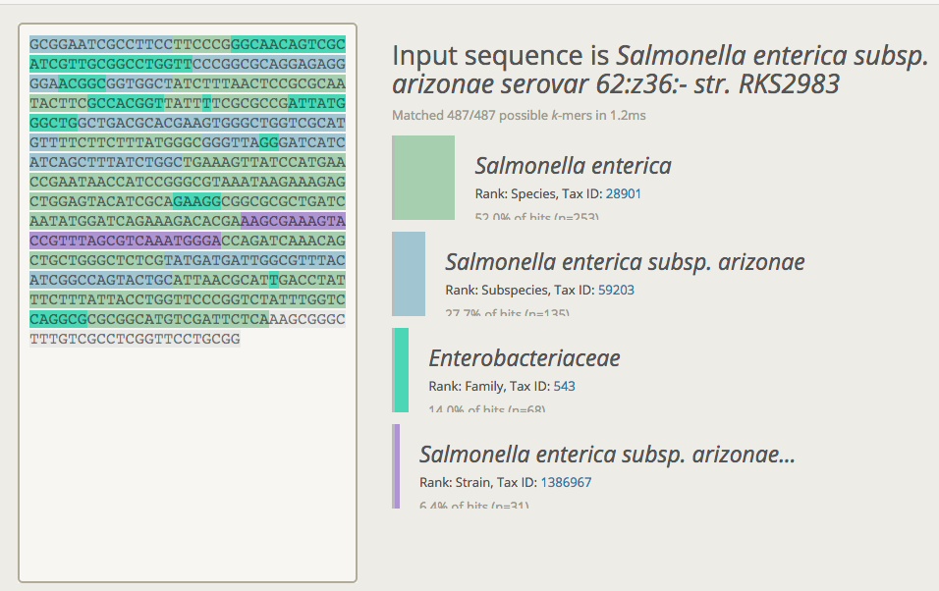
Each K-mer is assigned to a taxa
However each assignment is not species specific
The goal is to accurately identify the relative abundance at the species level using the taxa assigned to each read

Slide 4

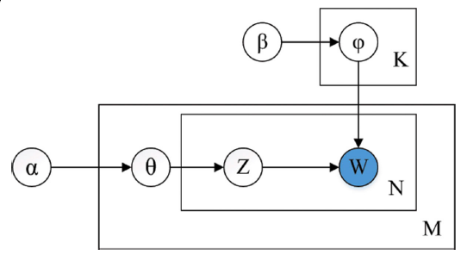
Exploit topic modeling approach to accurately identify relative abundance
I am integrating over a large number of read-level classification results to make analytical inferences that cannot be made from each independent sequence in isolation
Probability
of abundance
Words
Reads(Taxa)
Conjugate priors for Dirichlet Process
A distribution of distributions
Documents
.fastq files

